Slide 1
Pakistan Demographics, Health & Mortality Statistics
Muhammad Uzair Aslam

Slide 2
Introduction to Exploratory Sunday
Exploratory Sunday is a social awareness campaign initiated by StatDevs.
Every Sunday, we post weekly statistics and visualizations concentrating on Pakistan’s demographic, healthcare and socio-economic indicators.
The aim of this compaign is to raise awareness to masses about how Pakistan’s conditions stack up against Sustainable Development Goals.
These posts are made using Open Source data sets such as PDHS(2017-18), PSLM(2019-20), Pakistan Census (2017) data

Slide 3
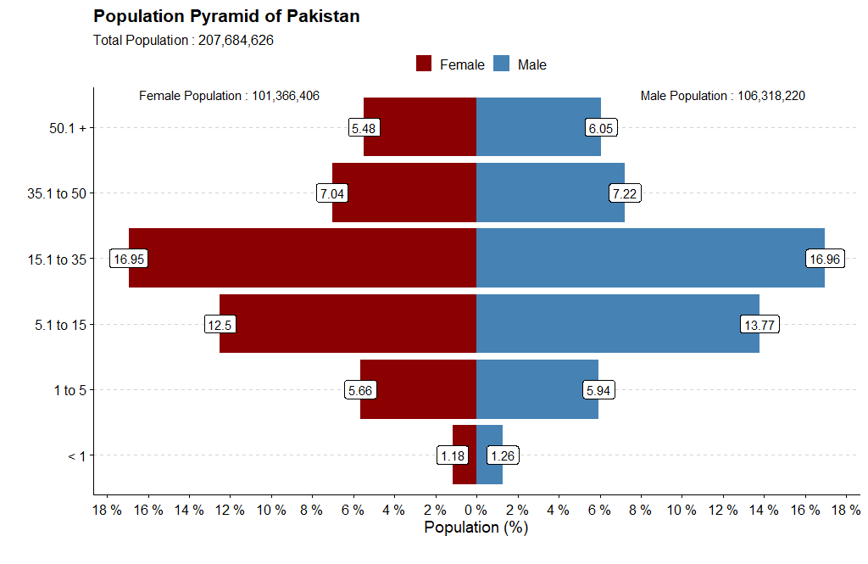
How is Pakistan Demographically distributed?

Slide 4
Male Percentage of population is 51.19% while female are 48.81% of Pakistan’s total Population.
For every 100 people in Pakistan, 64 live in Rural Areas of Pakistan.

Slide 5
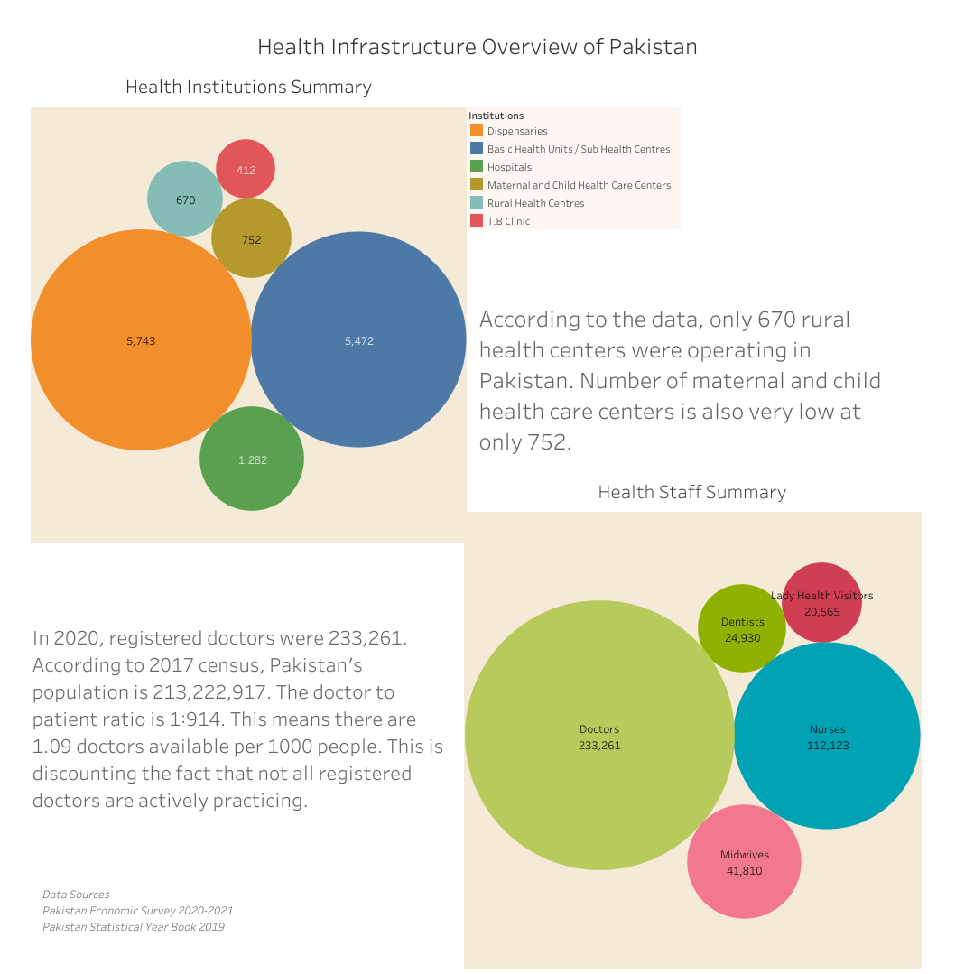
What is Pakistan’s Health Infrastruce Outlook?

Slide 6
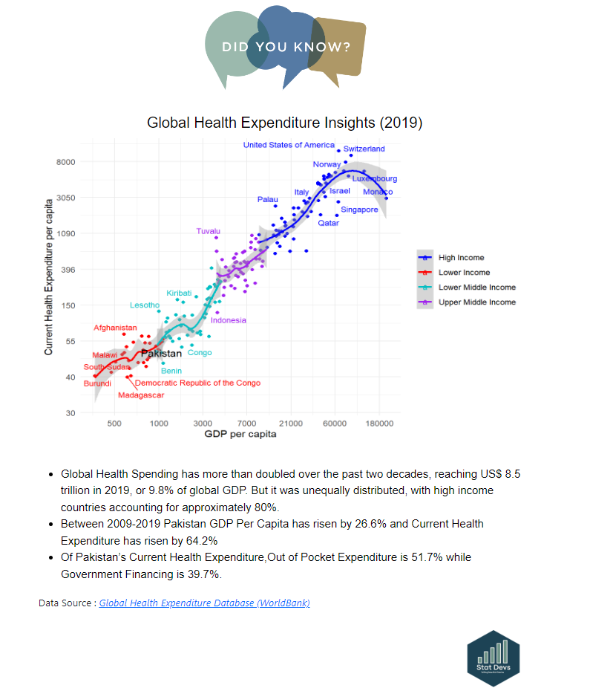
Pakistan sits in Lower Income group in Global Health Spending

